Slide 1
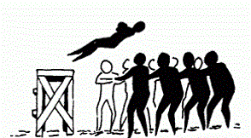
Should we have "trust issues" with our memory?
PSY 324
Module 3 Presentation 1

Slide 2
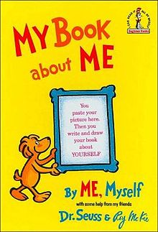
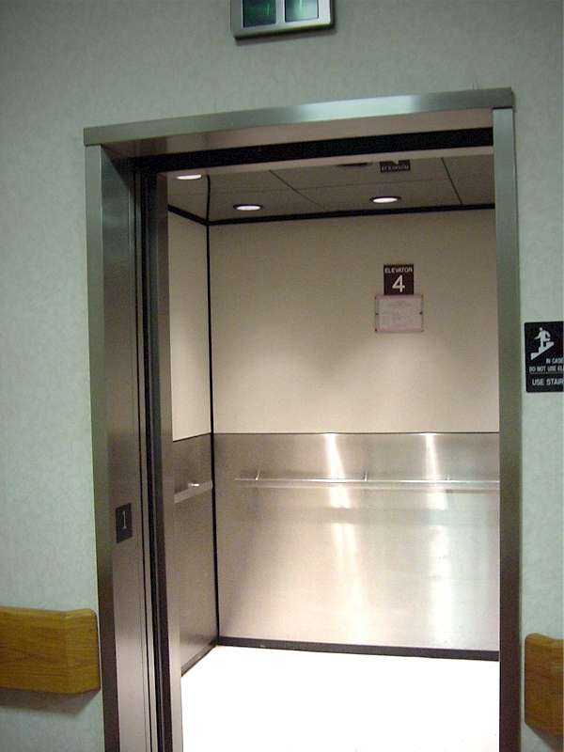
Autobiographical Memory
Schema
Gist
Consistency bias
Source monitoring
Reality monitoring

Slide 3

Flashbulb Memories
Flashbulb memory: a detailed account of circumstances surrounding an emotionally significant or shocking, sometimes historic, event

Slide 4
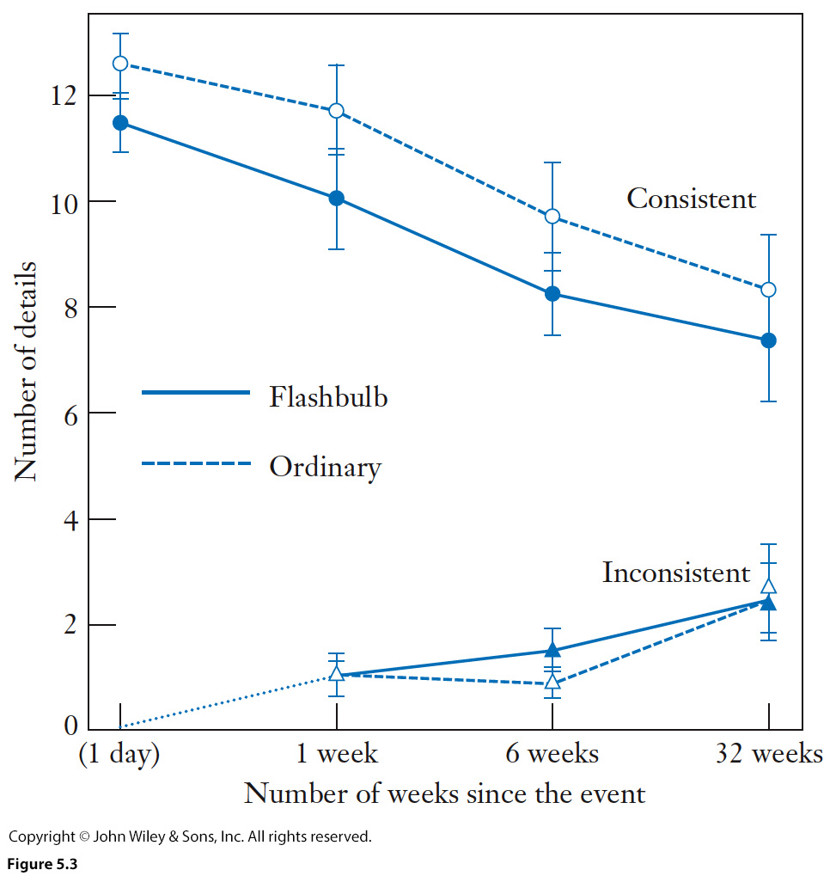

Slide 5
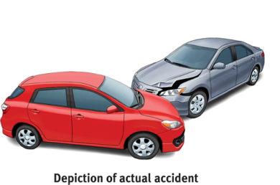
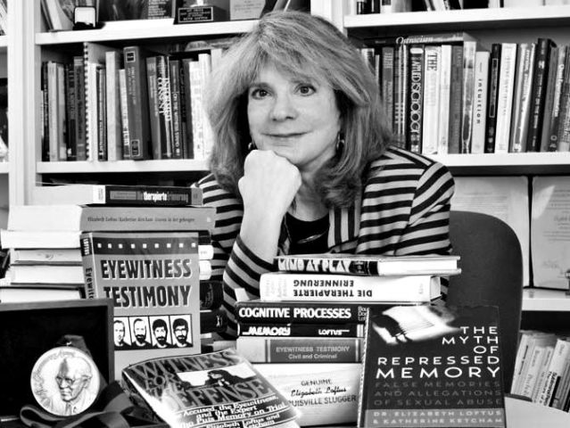
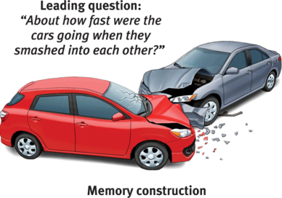
Eyewitness Testimony
Post-event misinformation effect
  Proactive interference
  Retroactive interference

Slide 6
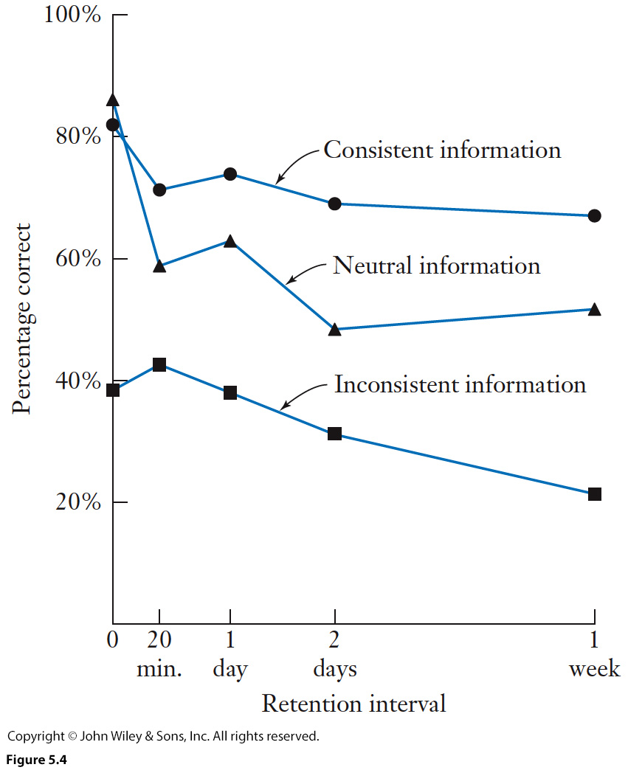

Slide 7
Factors Affecting Eyewitness Testimony
The constructivist approach
1) Eyewitnesses make more errors if they saw a crime committed during a stressful circumstance.
2) Eyewitnesses make more errors when there is a long delay between the events and when testimony is given.
3) Eyewitnesses make more errors when the information is plausible.
4) Eyewitnesses make more errors when there is social pressure.
5) Eyewitnesses make more errors if someone has provided positive feedback

Slide 8

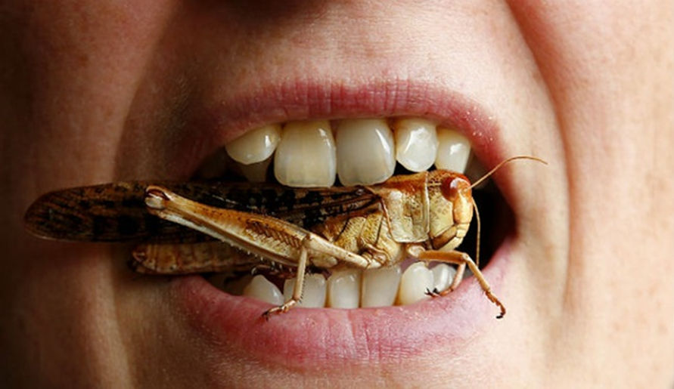
Emotions and Memory
We have more accurate recall for pleasant items.
We have more accurate recall for neutral stimuli associated with pleasant stimuli.
Over time, unpleasant memories fade more than pleasant memories.

Slide 9
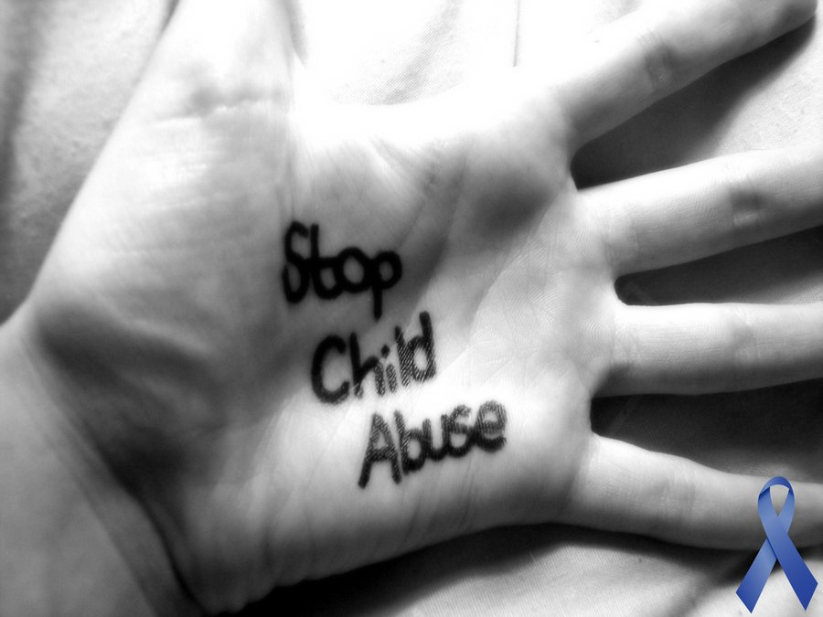
Recovered-Memory/False Memory

Slide 10
In closing . . .
“In essence, all memory is false to some degree. Memory is inherently a reconstructive process, whereby we piece together the past to form a coherent narrative that becomes our autobiography. In the process of reconstructing the past, we color and shape our life’s experiences based on what we know about the world.”
Bernstein, D.M. & Loftus, E.F. (2009). How to tell if a particular memory is true or false.
Perspectives of Psychological Science, 4, 370-374.

